Slide 1
Online Crime Portal
Project By:
RUTUJA DIVASE
PRADNYA KARPE
NEHA SHAHANE
Guided By:PROF.DEEPIKA SARWARE

Slide 2
Introduction
The Online Crime Reporting System is developed on php and SQL Server. The main aim for this project is to provide all crime management solutions which are easily accessible by everyone.
The system starts with every person who wants to login a complaint through the internet so that it is very useful for the police department and social worker to find out the problem in society without making people come to the police station every time. The main purpose of the system is to manage criminal details in a centralized database and provide solution for public to give complaint through online. This project provides a lot of features to manage all the data in a good manner. The system has been developed to override the problems prevailing in the manual system. The project is supported to eliminate and reduce the hardships faced by the existing system.

Slide 3
Scope of the project
This website provides an architectural overview of crime management. This web site is generic. A web-based tool that enables the user to manage the crime on tasks completed as part of a project with tasks and sub-tasks. The tool includes interactivity, Functionality, Information will be stored into a database. Administrative and managerial functions will be provided including configuration projects/tasks/subtasks.

Slide 4
Front end: HTML, CSS, JavaScript
HTML: HTML is used to create and save web documents. E.g. Notepad/Notepad++
2. CSS : (Cascading Style Sheets) Create attractive Layout
3. Bootstrap : responsive design mobile friendly site
4. JavaScript: it is a programming language, commonly used with web browsers.
Back end: PHP, MySQL
1. PHP: Hypertext Preprocessor (PHP) is a technology that allows software developers to create
dynamically generated web pages, in HTML, XML, or other document types, as per client request. PHP is
open source software.
2. MySQL: MySql is a database, widely used for accessing querying, updating, and managing data in
databases

Slide 5
Existing System
Currently there is no online web application available to report crime online. In order to report any complaints related to crime, people have to contact the nearest police station. People of the particular city are not aware of crime related things such as list of Most Wanted criminals of their city, latest crime related news, missing persons of their area etc..People have to view News Channels or Read News Paper for such crime related information. Thus we can say that the existing system is manual and does not provide all the information from one source.
Almost all operations are done manually in the existing crime management system, such as signing complaints, taking actions against crimes, viewing status, etc. So with the existing system, if someone needs to register a complaint, he must do it through the police. If it is done manually, numerous minor errors will occur. Error detection in the previous entries and data cross verification is another essential operation. These are done manually, and it would take time.

Slide 6
Drawbacks of the existing system can be concluded as follows:
1. The existing system is time-consuming and not very user friendly.
2. Even a sincere and experienced officer cannot lead more than one case at a time.
3. In many case, due to bribery, the innocents are accused in the existing system since the records
are manually kept, which is easy to manipulate.
4. Moreover, the records are not centralized. Hence changes made might not reflect everywhere.

Slide 7
Proposed System
In this system there are two different interfaces, one is for the public which is the public portal in which registration can be done by the public sector and then comes the other portal which is the admin portal which is controlled by a government organization.
Now the proposed system is developed to solve all the problems that occurred in the earlier systems by automating most of the operations. Keeping in mind that the type of users can range from someone who knows how to work with computers to someone who knows nothing about them, this application can be used by all by providing a user-friendly interface. In today's world, where all people lack time, this application lessens time consumption. It also provides better communication and faster updation of data.

Slide 8
Objective Of The Project
The main objective of the Online crime portal is to manage the details of crime,police,police department, cases. It manages all the information about crime, complaint, department, crime. The project is totally built at the administrative end and thus only admin is guaranteed access. the Purpose. The purpose of the project is to build an application program to reduce the manual work for managing the crime, complaints, complaints. It tracks all the details about the complaint department..

Slide 9
The Objective of Crime Reporting System is to develop a web based application using which people can report crime online. It also provides the information of missing persons, most wanted criminals and safety tips for the awareness of people.The main purpose of developing the online crime reporting system is for the welfare and safety of the public. Due to some factors in today’s time, the public sometimes do not trust the government officials, due to this they don’t ever want to go to the station and file a report. So this system will reconstruct the bridge between the two - public and government officials respectively. So now if anyone want to file a complaint or misconduct, they can do it easily from their home

Slide 10
Operationa environment
2.1 HARDWARE REQUIREMENTS:
Intel Pentium or More.
b. 2GB RAM
c. PC with 80 GB ROM
2.2 SOFTWARE REQUIREMENTS:
a.XAMPP, chrome (any browser)
b.Platform – Windows / Linux

Slide 11
Digrams

Slide 12
ER-Diagram

Slide 13
Zero Level DFD

Slide 14
Dfd for user

Slide 15
Dfd for police officer

Slide 16
Use Case Diagram

Slide 17
SCREEN LAYOUTS

Slide 18
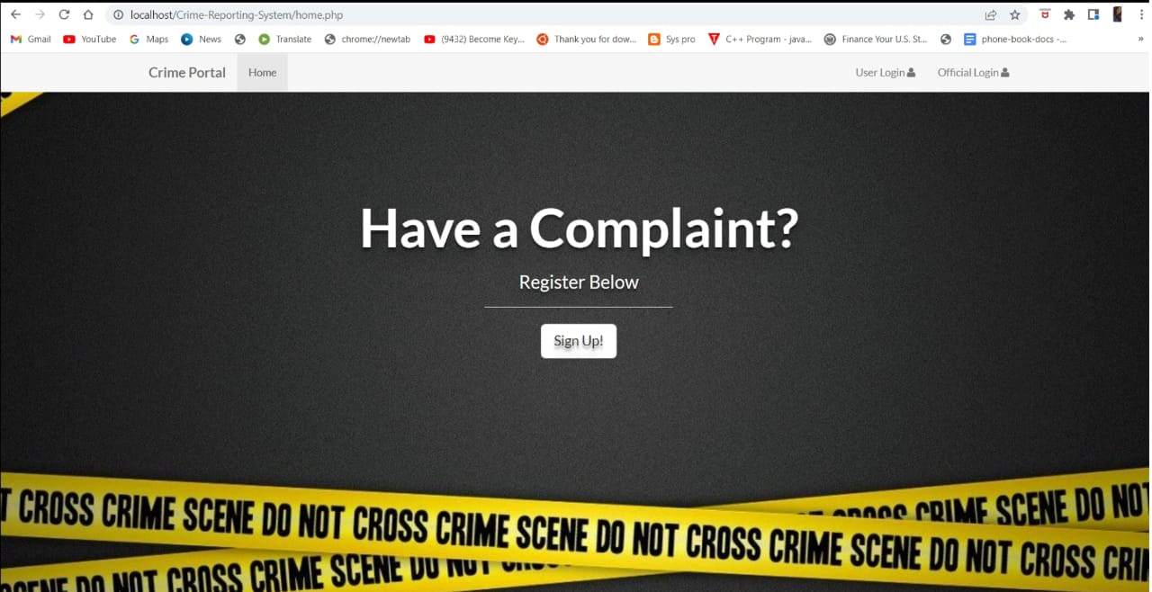
Main Screen

Slide 19
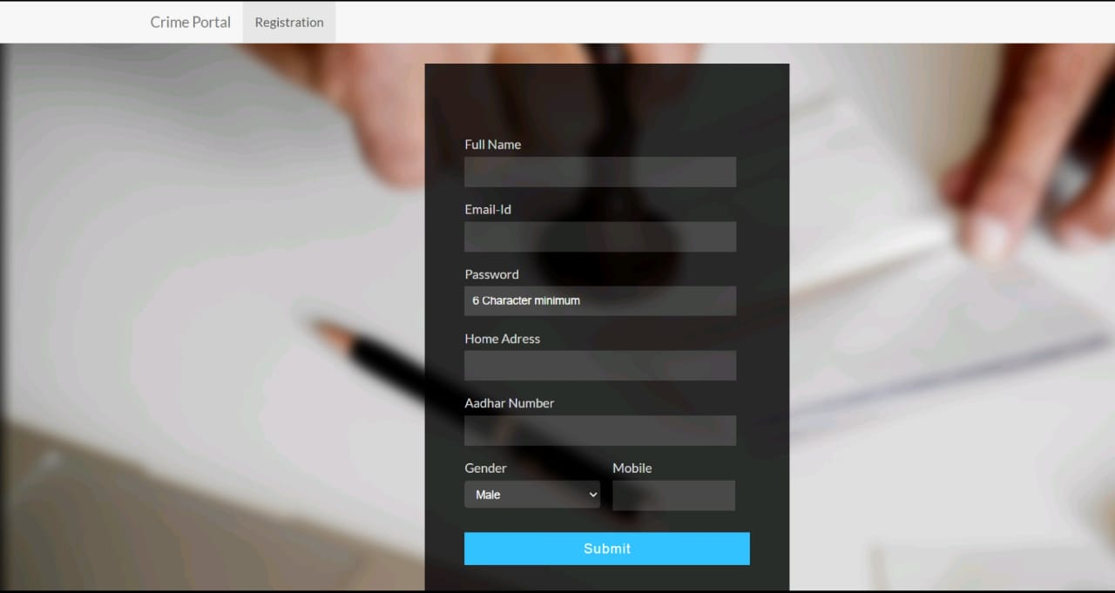
Registration

Slide 20
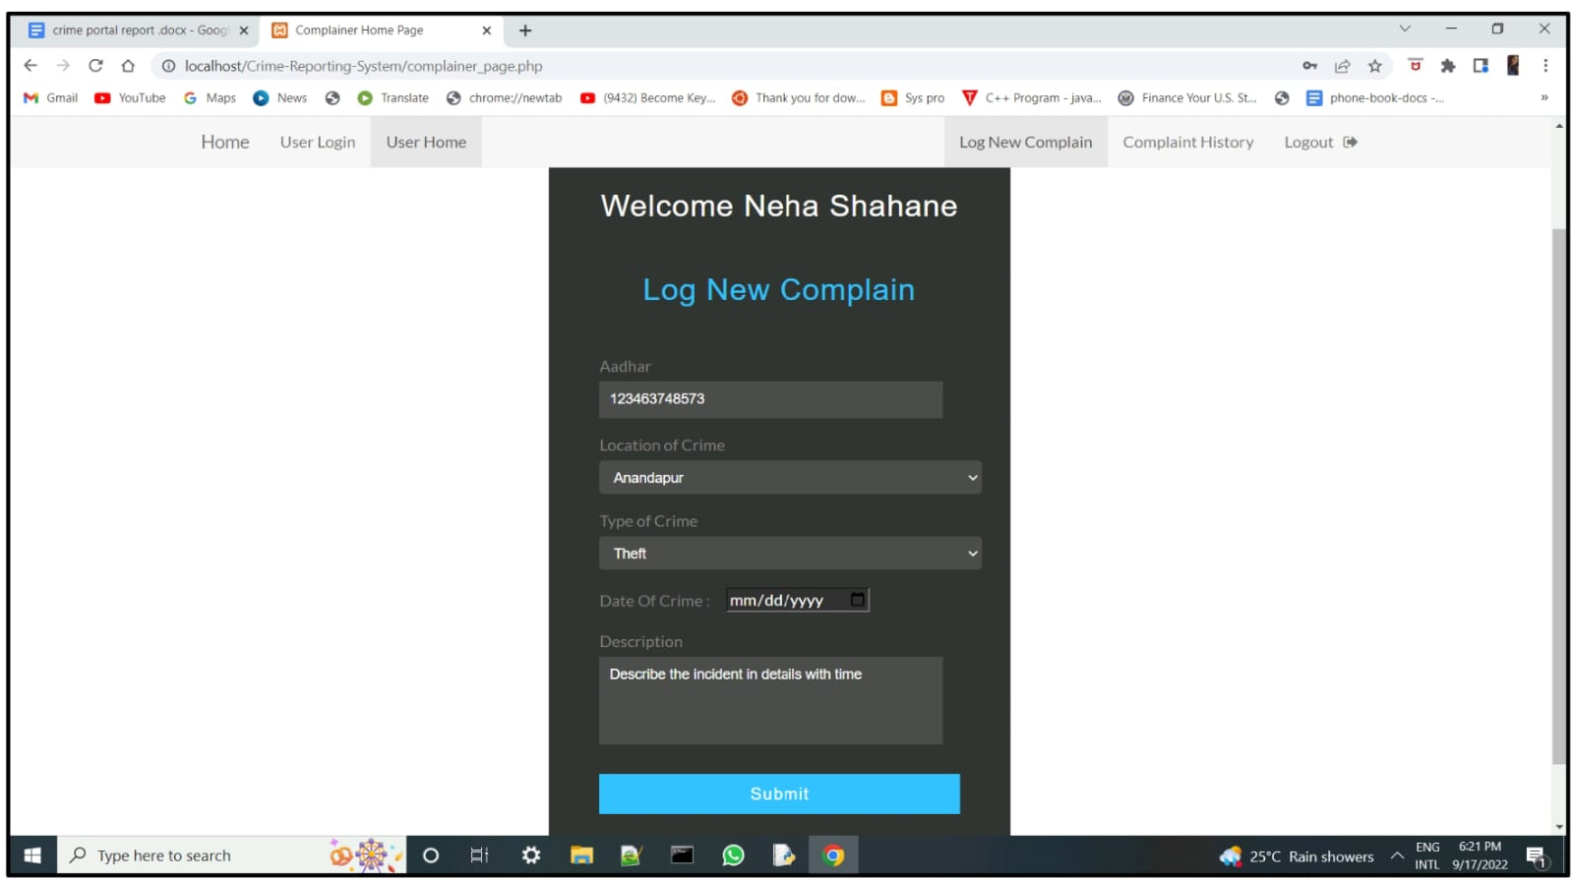
New Complaint Registration Form

Slide 21
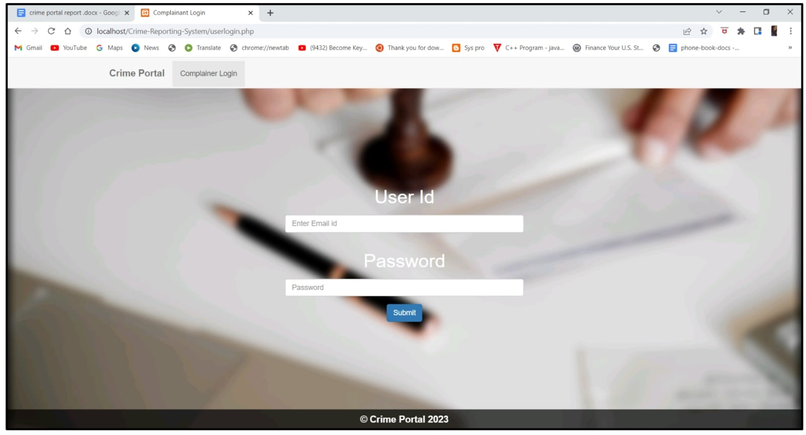
User Login

Slide 22
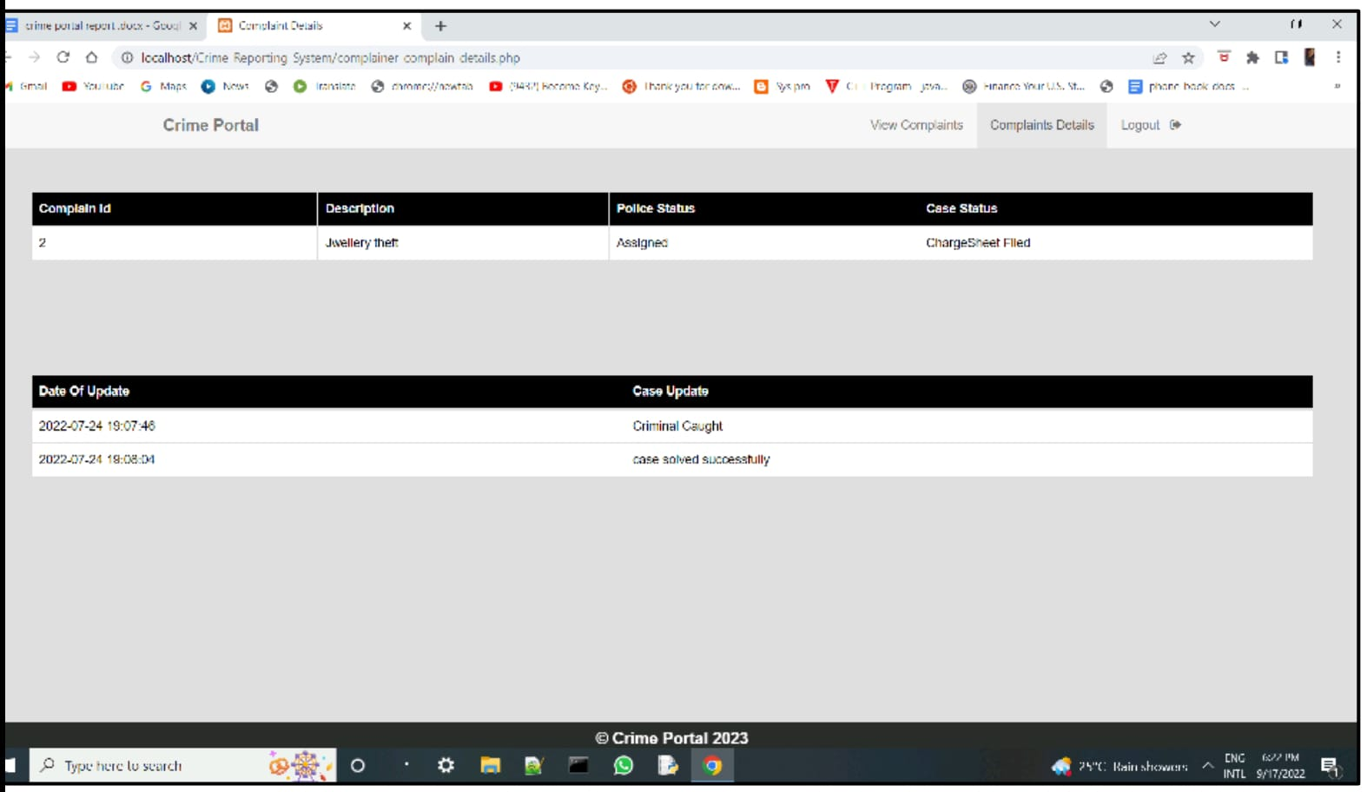
Complaint Status

Slide 23
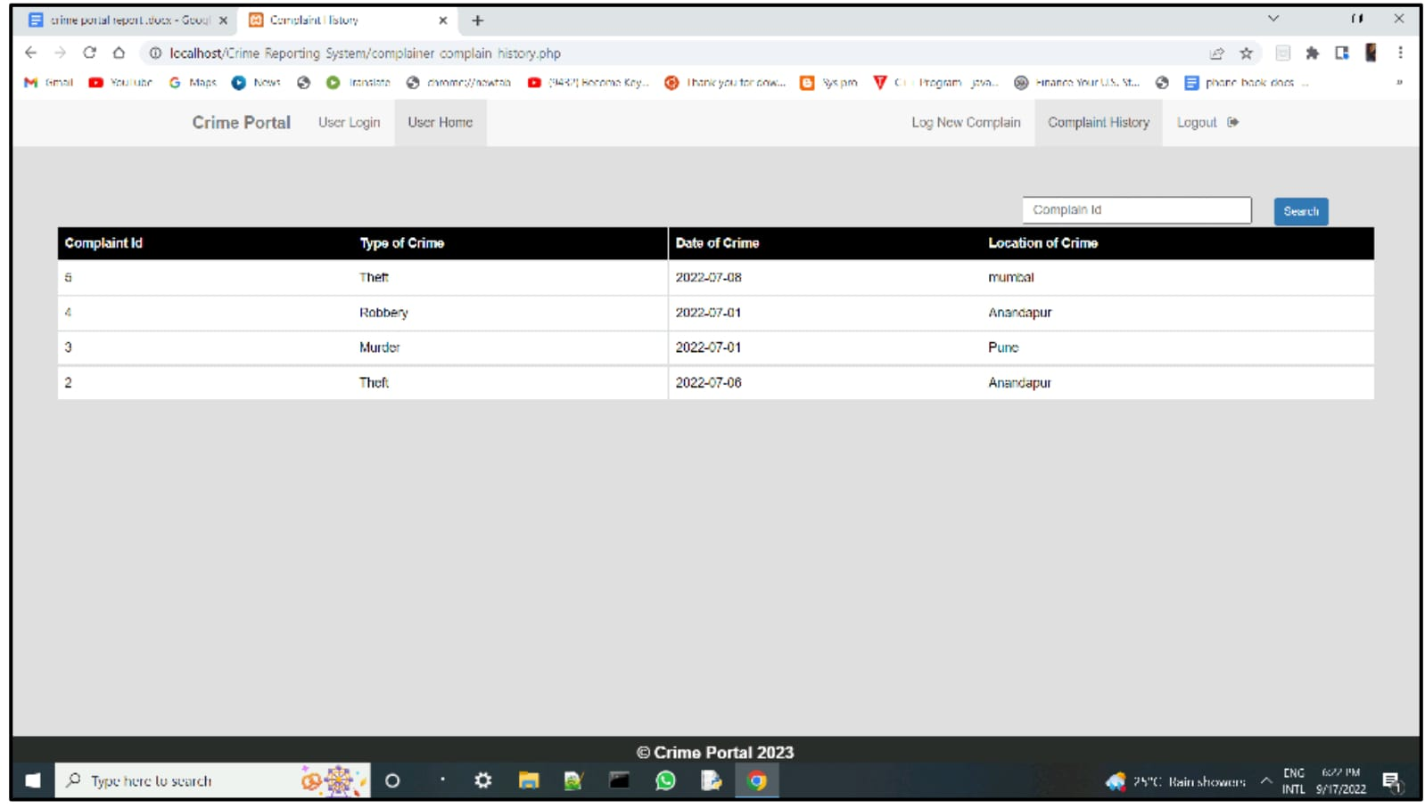
Complaint History

Slide 24
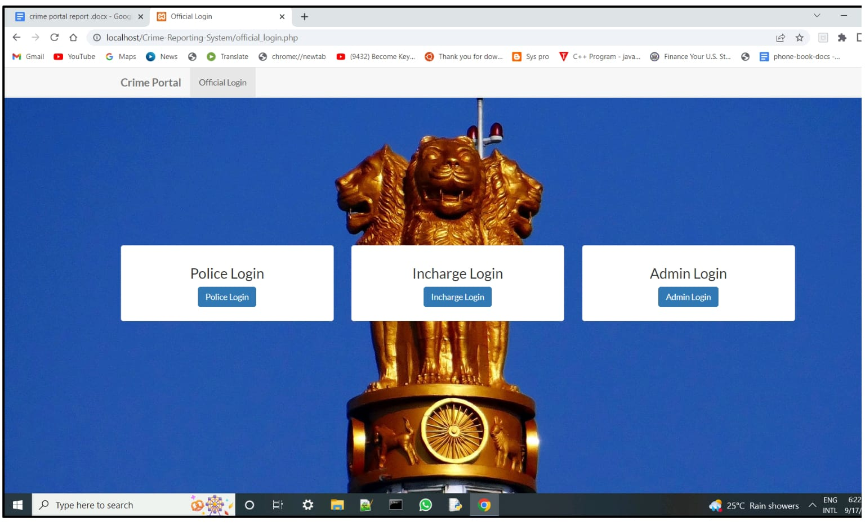
Official Login

Slide 25
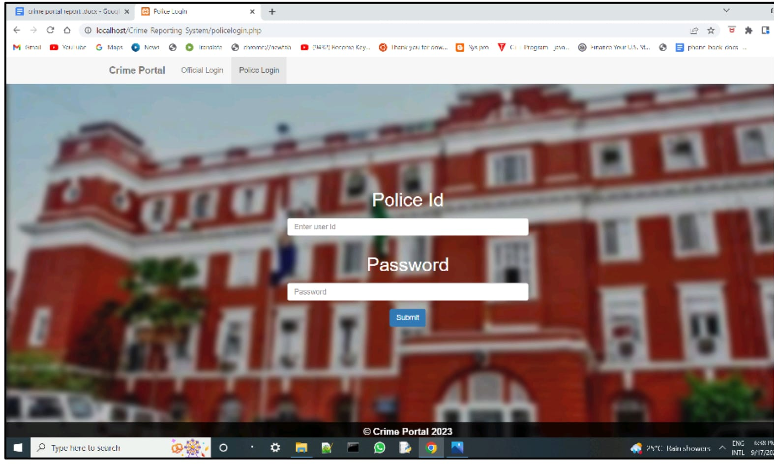
Police Login

Slide 26
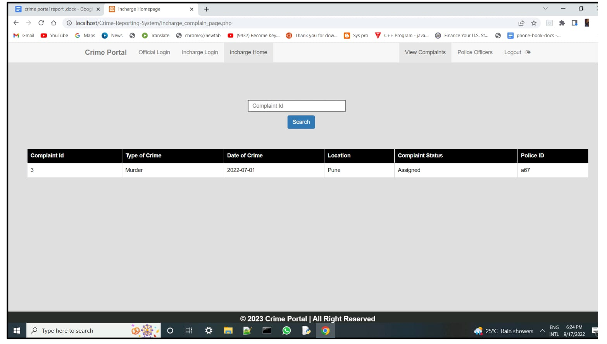
View Complaints

Slide 27
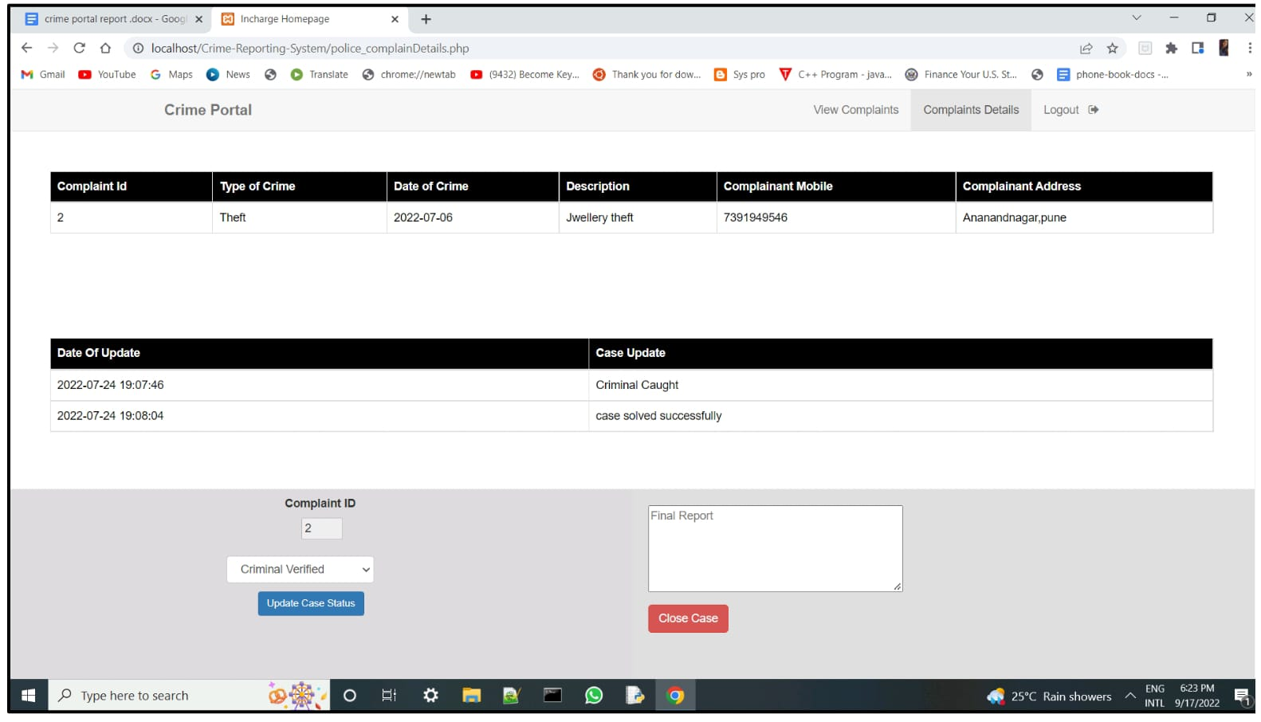
Complaints Details

Slide 28
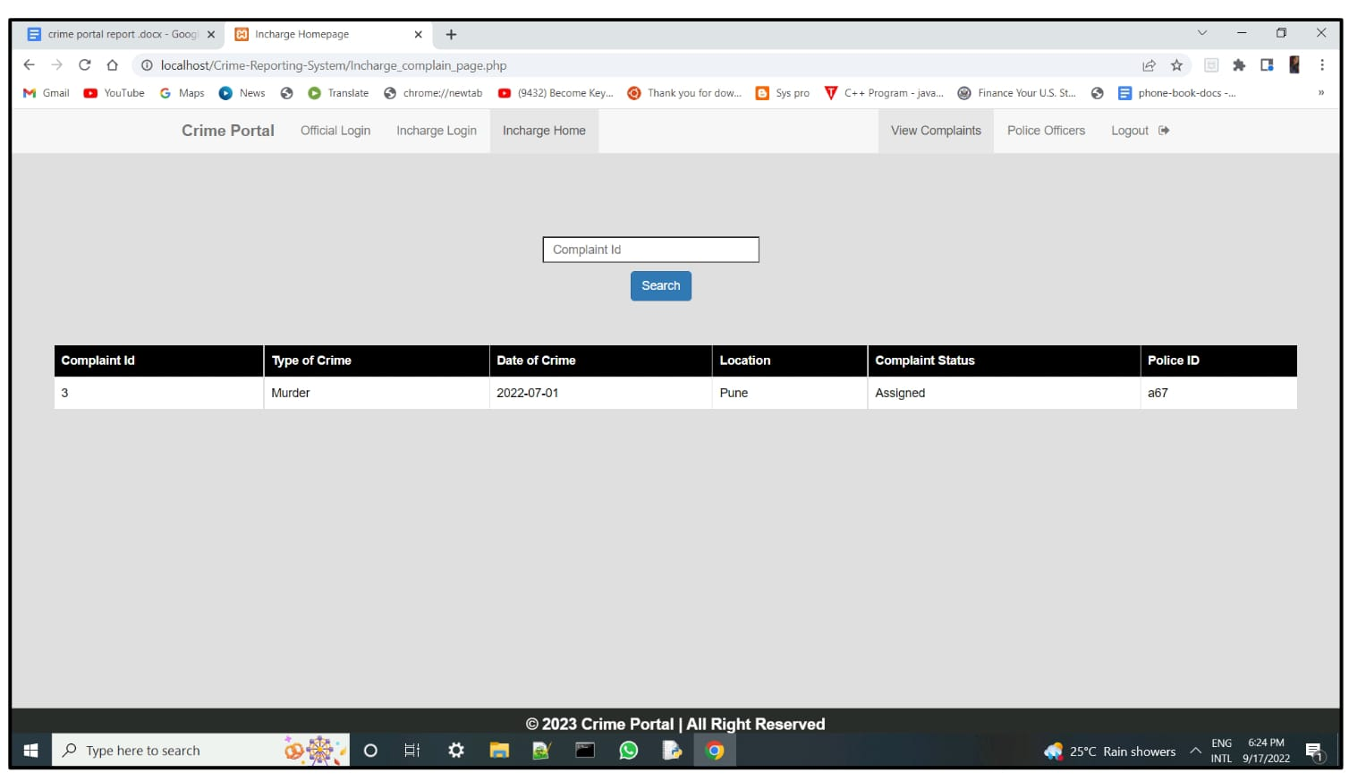
Incharge Login-Home page

Slide 29
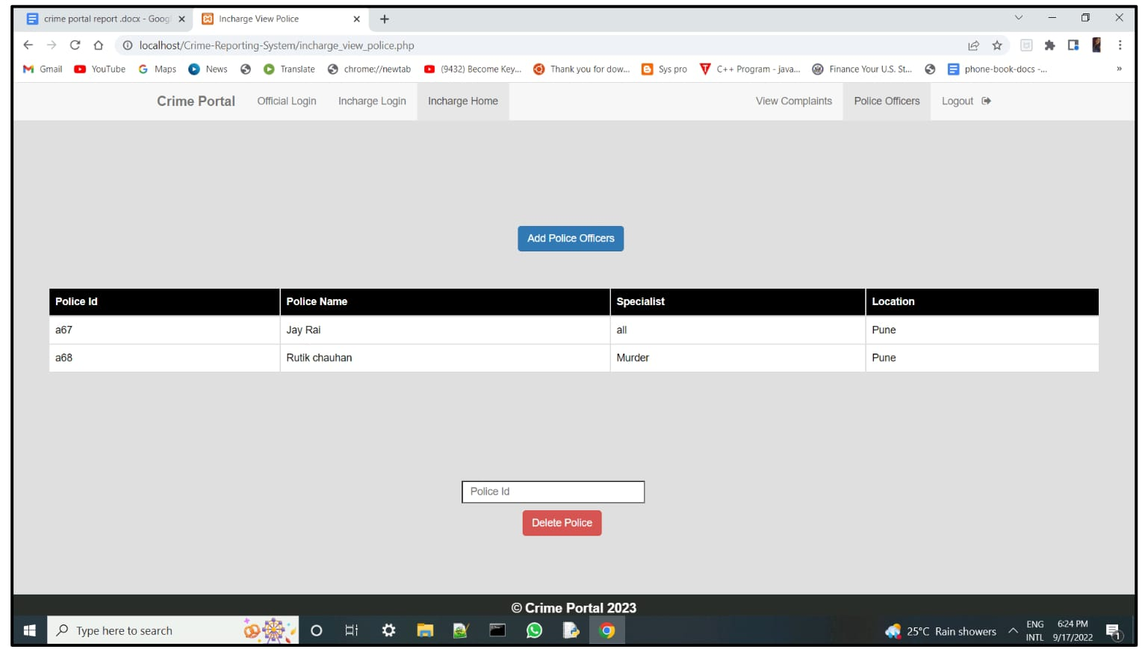
Add/Delete Police Officers

Slide 30
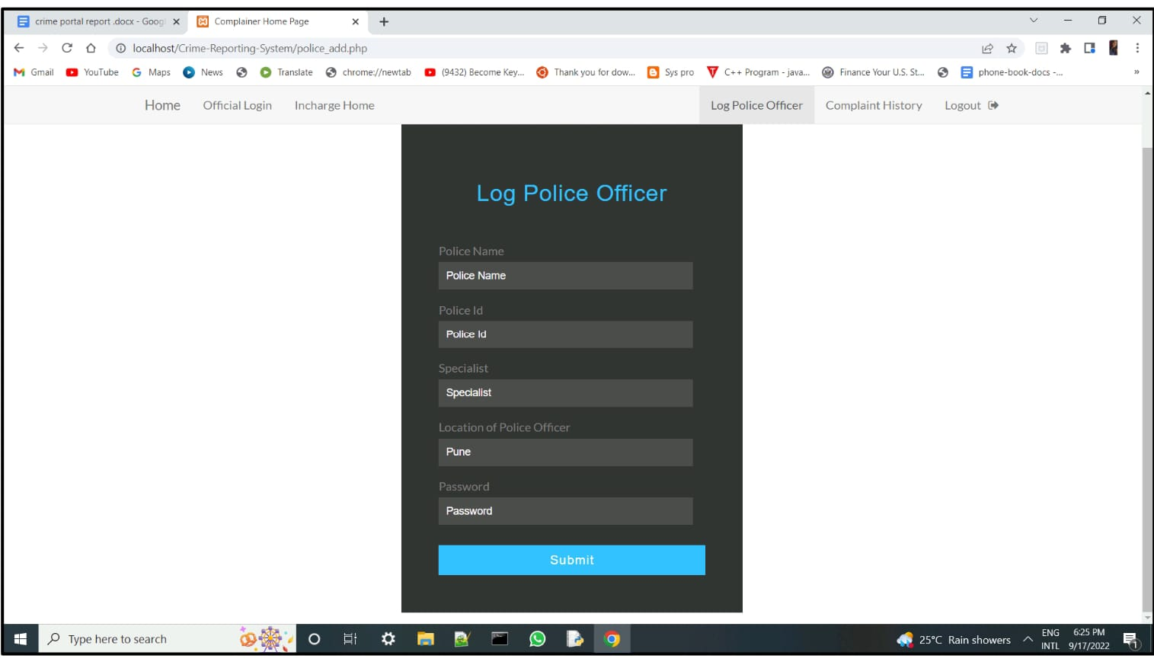
Police Registration Form

Slide 31
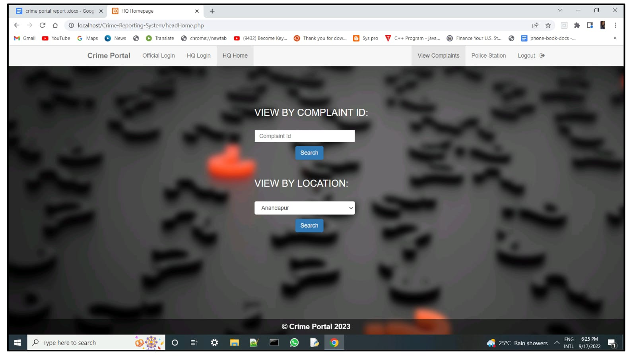
Head Login-Home Page

Slide 32
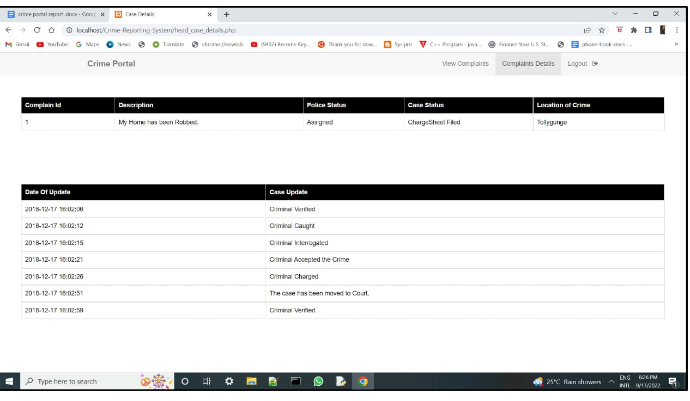
Search Complaint Details

Slide 33
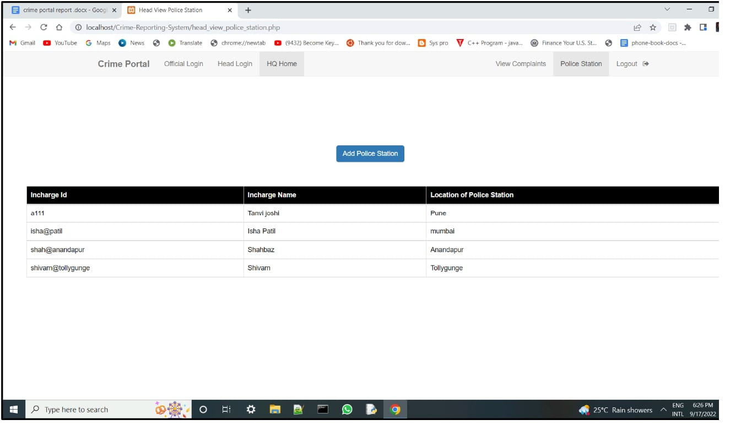
Police Station Detail

Slide 34
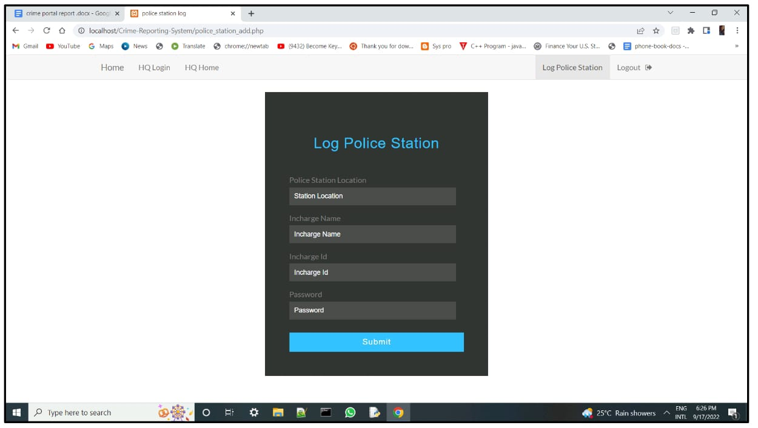
Police station Registration

Slide 35
References Links
www.google.com
www.tutorialspoint.com
w3school.com

Slide 36
Thank you

